Slide 1


Visvesvaraya Technological University, Belagavi, Karnataka Jawaharlal Nehru New College of Engineering, Shivamogga - 577204 Department of Computer Science & Engineering A DBMS MINI- PROJECT ON “SCHOOL DATABASE MANAGEMENT”
SUBMITTED BY
NAME: USN:
AISHWARYA S 4JN20CS004
CHANDANA C S 4JN20CS025
JEEVITHA V 4JN20CS040
MAHATHI KASHYAP 4JN20CS052
Under the guidance of
Mrs. Sowmya D. _{M.Tech, (Ph.D)} Asst. Professor, Dept. of CS&E, JNNCE, Shivamogga | Mr. Mallesh Kumar K S _{B.E, M.Tech} Project Manager Centre for Innovation & Entrepreneurship JNNCE, Shivamogga

Slide 2
Content
Problem statement
Abstract
Objectives
Requirement Specification
ER & Schema Diagrams
Results & Snapshot
Conclusion
Future Scope
References

Slide 3
PROBLEM STATEMENT
School database management is a project that manages and stores school information electronically according to school’s need. The system helps teachers to keep a constant track of all student’s data. It becomes necessary for school to keep a continuous check on the student’s performance and attendance status.
This task if carried out manually will be tedious and includes chances of occurrence of mistakes. These errors are avoided by allowing the system to keep track of information such as student ID, student name, DOB, address, parent info, academic performance, attendance. And thus there is no need to keep manual track of this information which thereby avoids chances of mistakes.
Thus, this system reduces manual work to a great extent allows smooth flow of library activities by removing chances of errors in the details.

Slide 4
ABSTRACT
School Database Management System is software which is helpful for students as well as the school authorities. In the current system all the activities are done manually.
It is time saving and scalable. Our School Database Management System deals with the various activities related to the School.
In the software we can login as a user and user has three types :
1)Student
2)Teacher
3)Employee
Teacher has the power to add new user and can edit the students details entered. A
employee can add students record ,attendance status with department wise. All students
can search his/her basics details and attendance status with their respective roll numbers.

Slide 5
OBJECTIVES
It describes how School database Management System is Developed to manage database of the SCHOOL.
To create a database of the student , teaching and non-teaching staff.
To evaluate the need for a management perspective to improve outcomes of the school.
To list all the student and staff information that are available in school.

Slide 6
REQUIREMENT SPECIFICTION
Software requirements:
Operating system - Windows 10
Backend - MySQL(Netbeans IDE 14)
Front end - Java swings
Platform - Jdbc jar

Slide 7
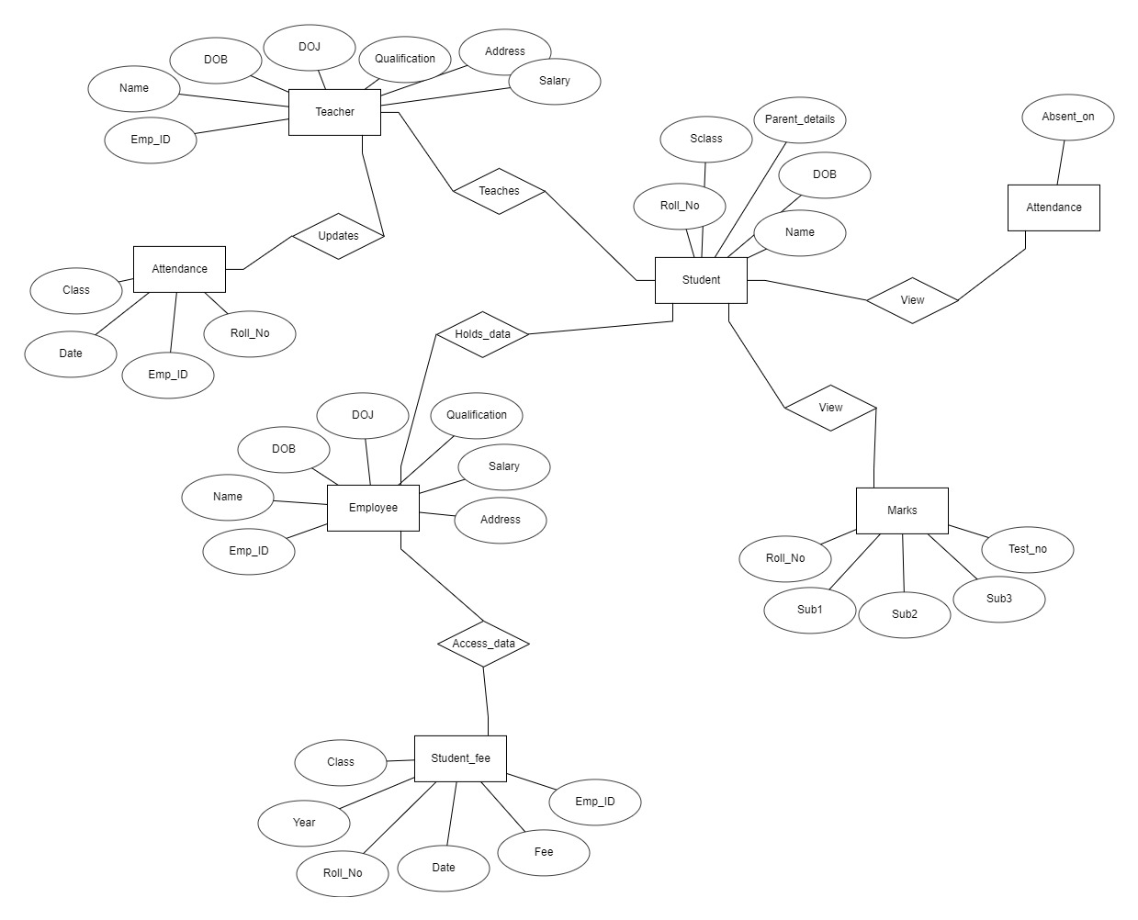
ER DIAGRAM

Slide 8
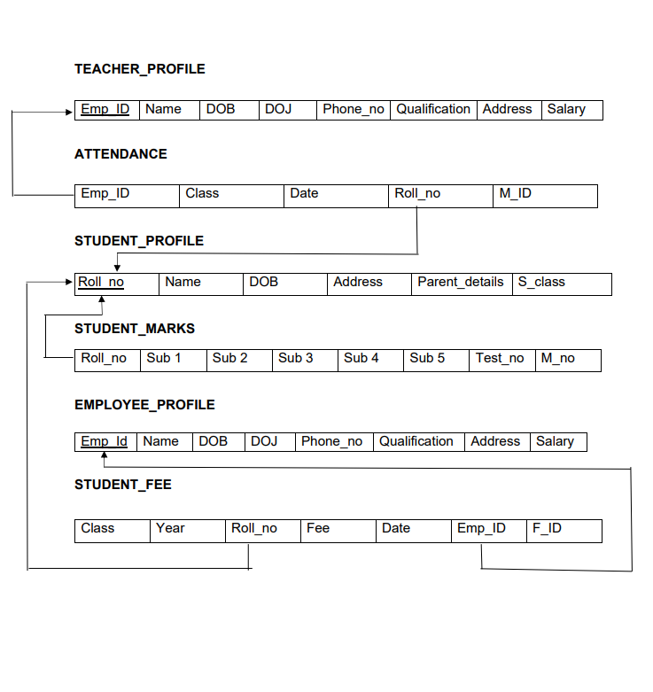
SCHEMA DIAGRAM

Slide 9
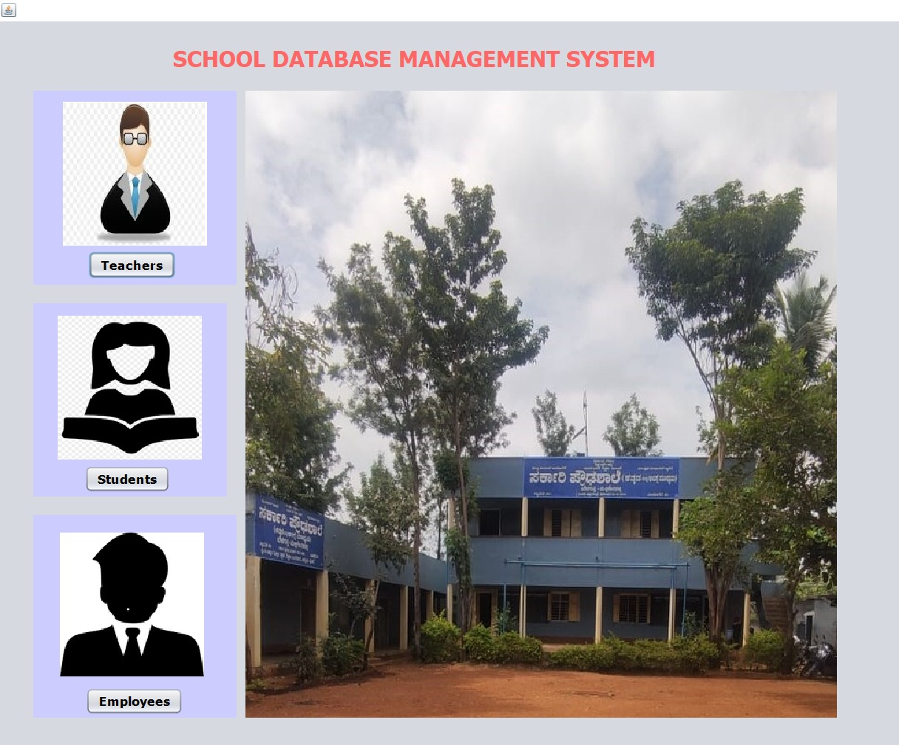
FRONT TABLES
DASHBOARD:

Slide 10
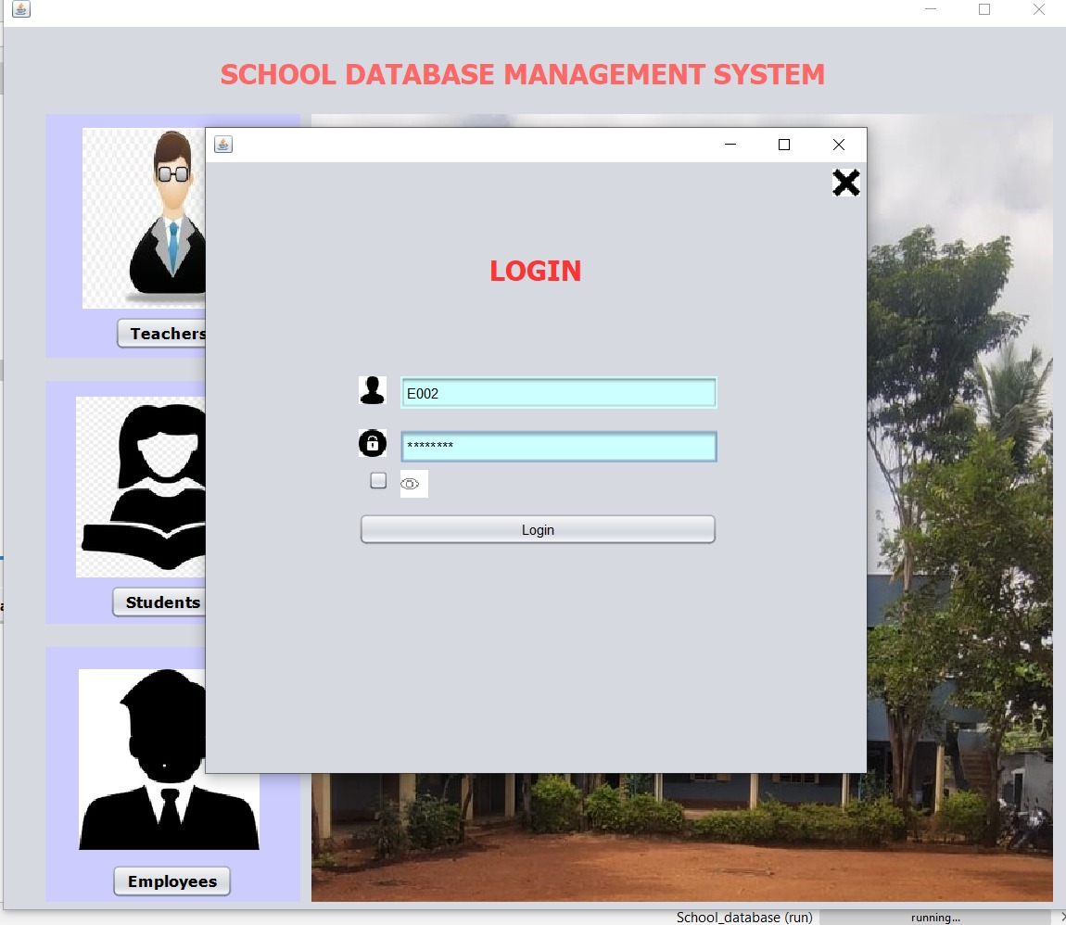
LOGIN FORM:

Slide 11
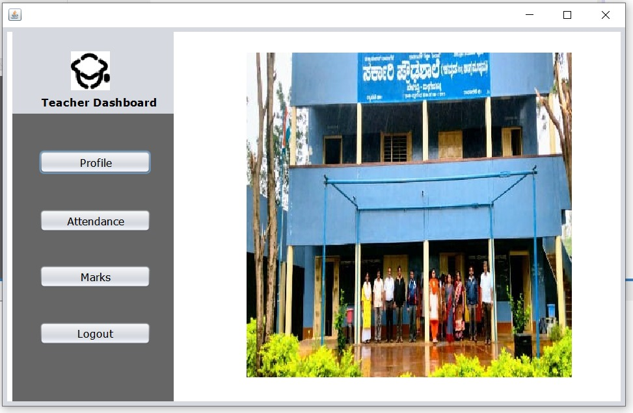
Teacher Dashboard:

Slide 12
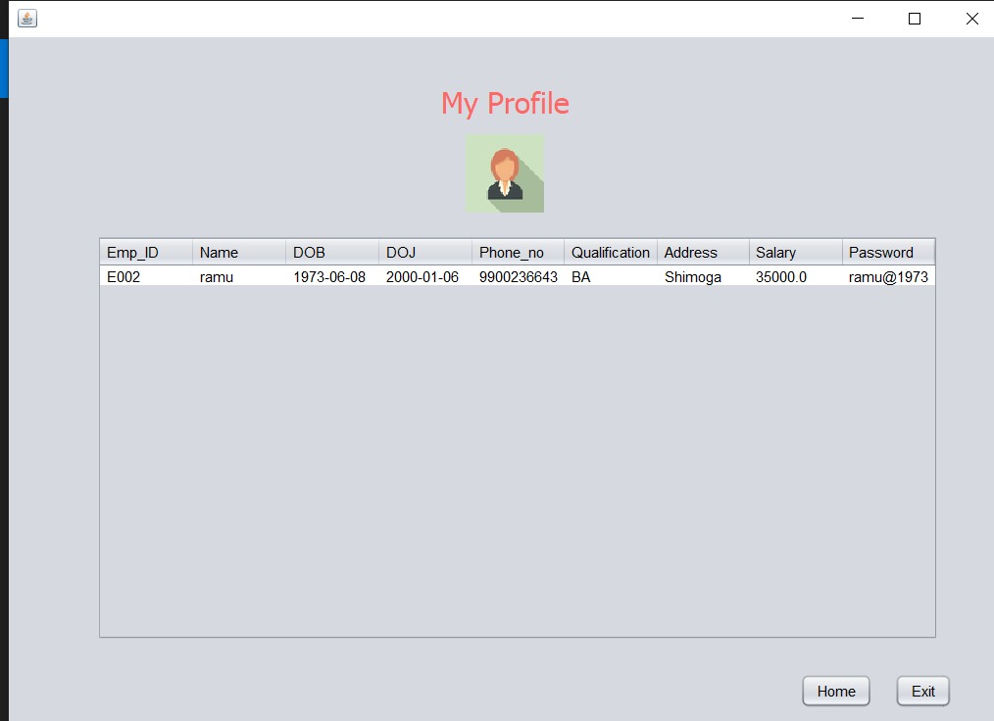
Teacher profile:

Slide 13
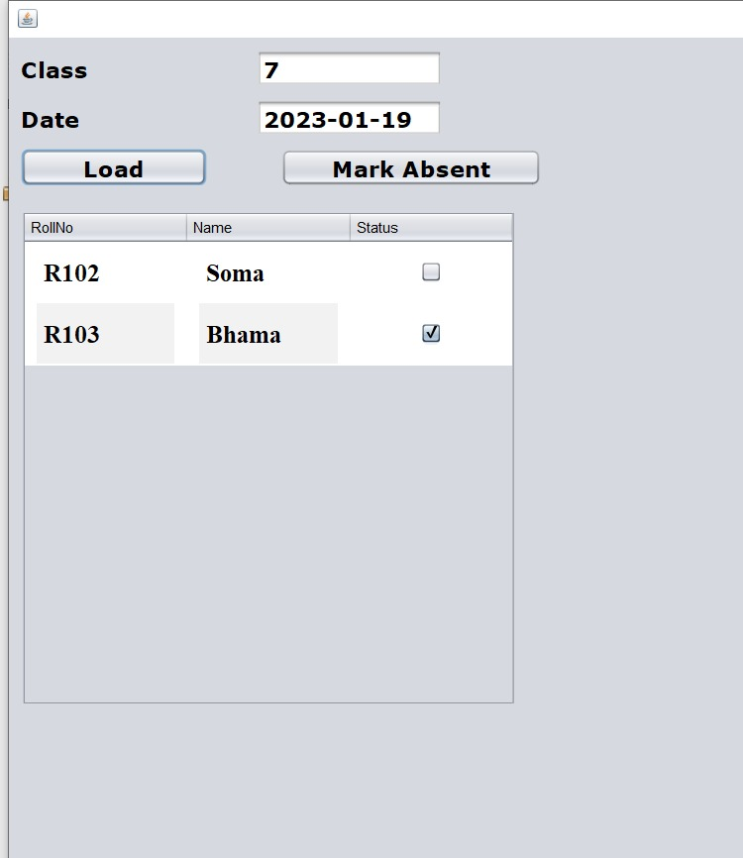
Attendance Marking:

Slide 14
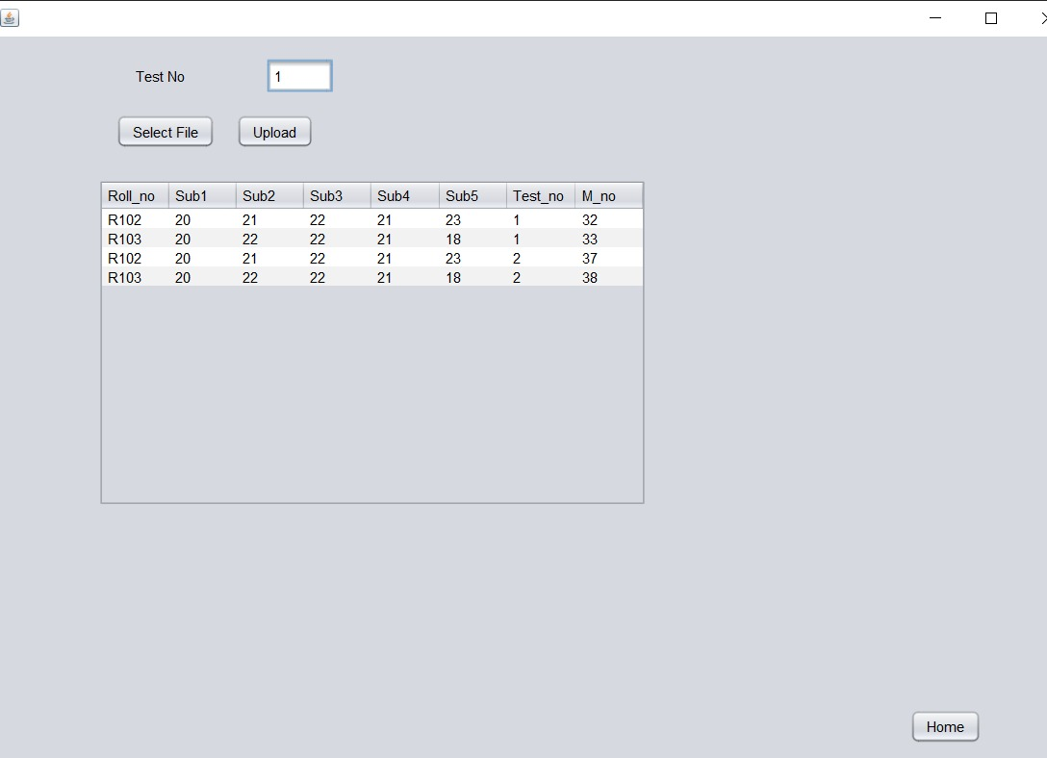
Marks entry:

Slide 15
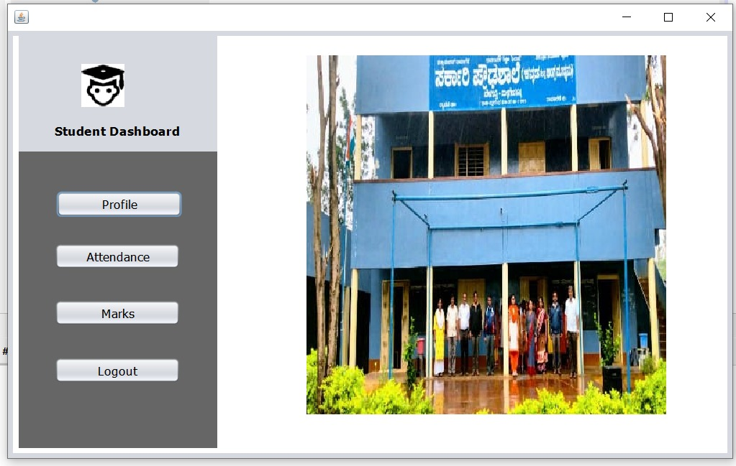
Student Dashboard:

Slide 16
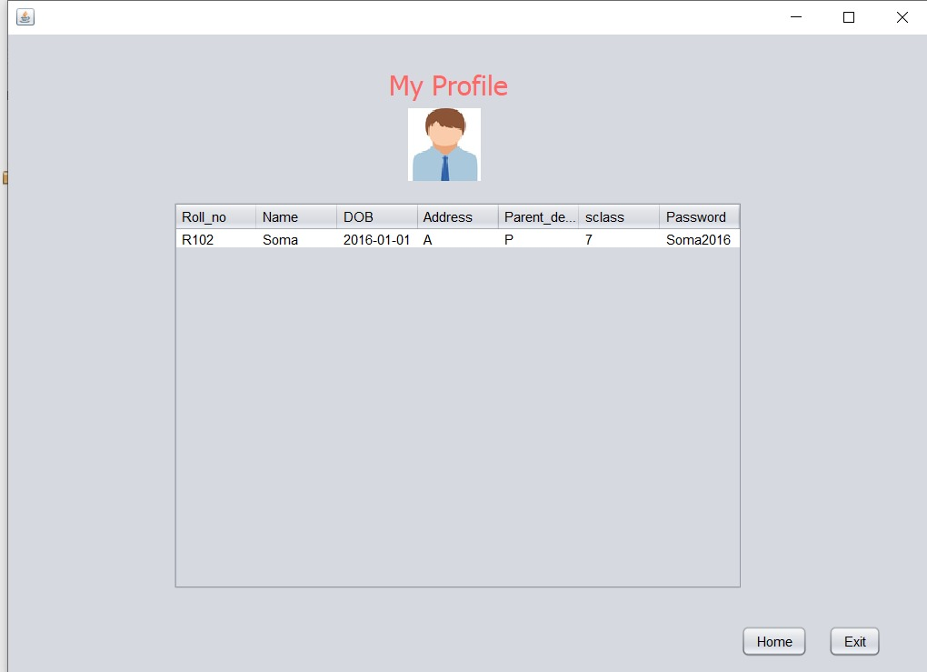
Student profile:

Slide 17
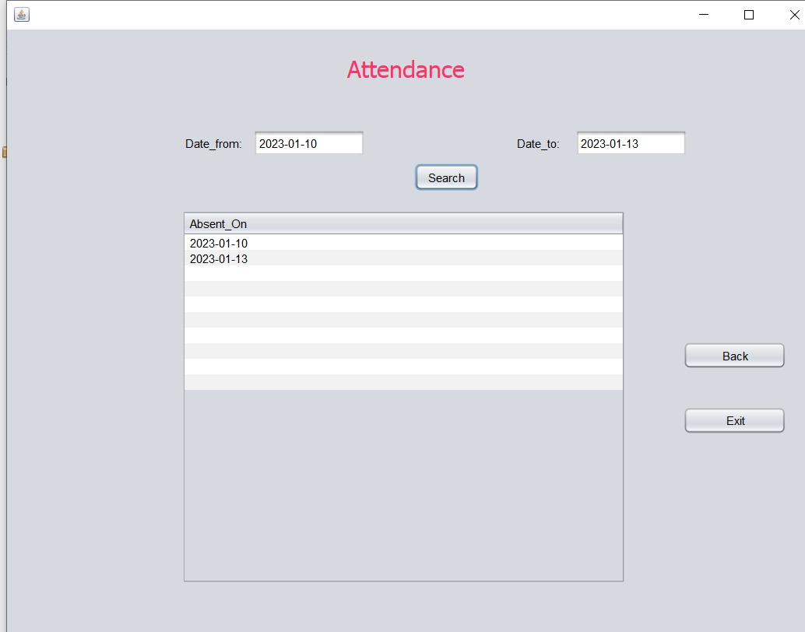
Student Attendance view:

Slide 18
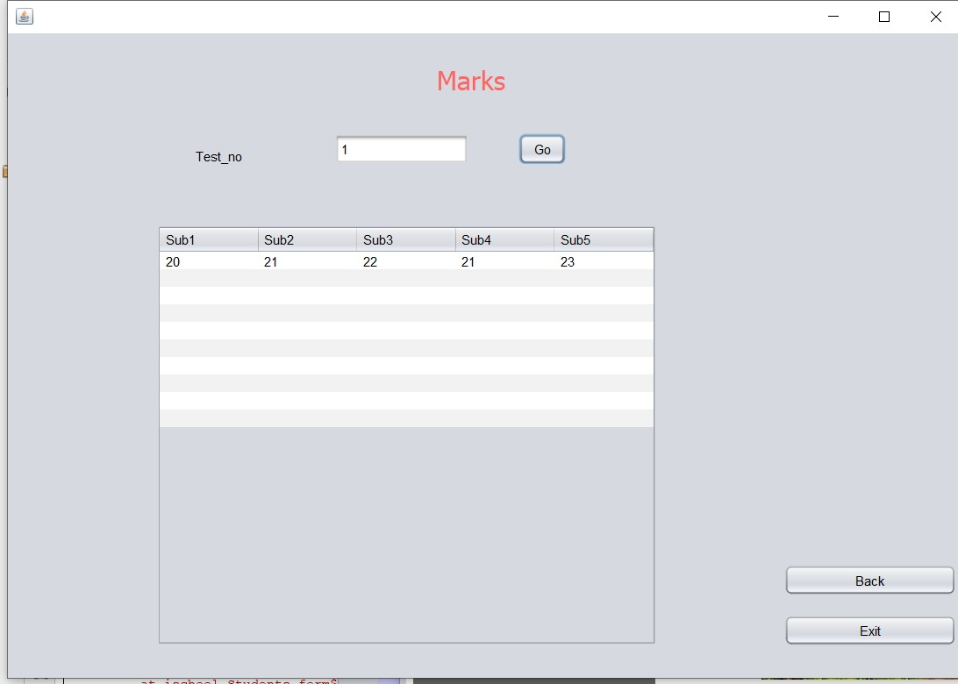
Student marks view:

Slide 19
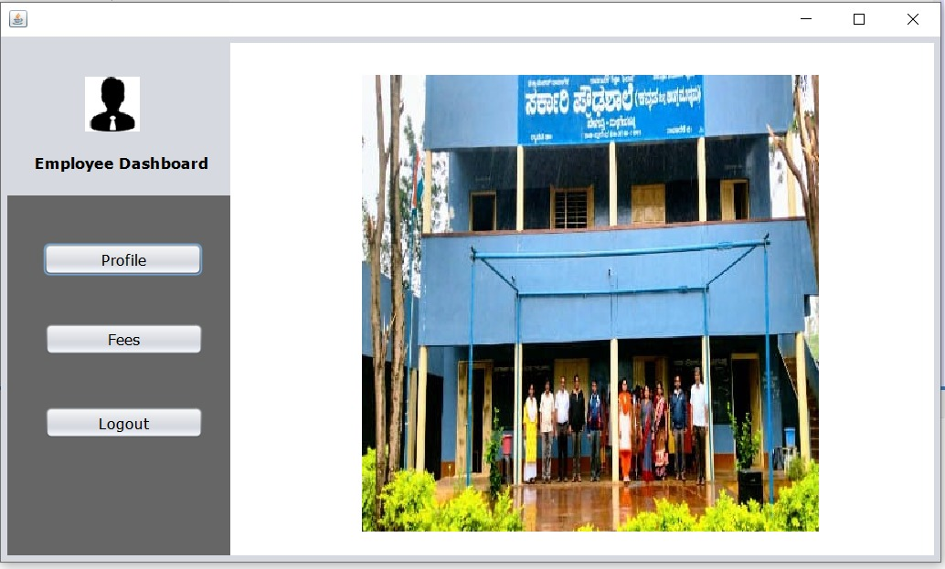
Employee Dashboard

Slide 20
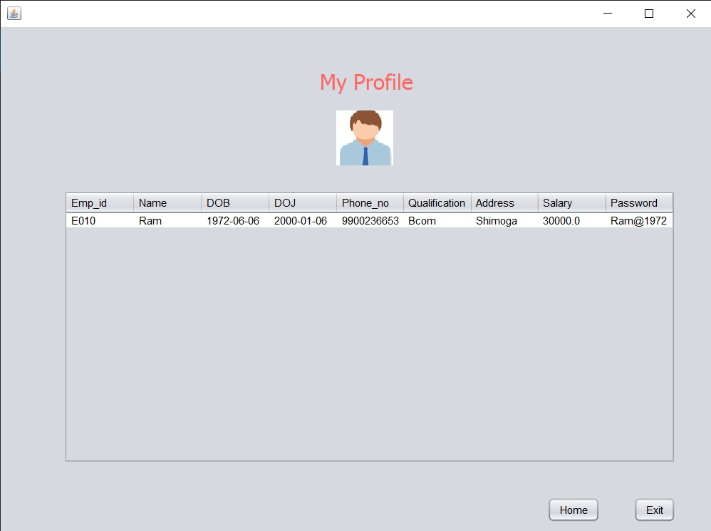
Employee profile:

Slide 21
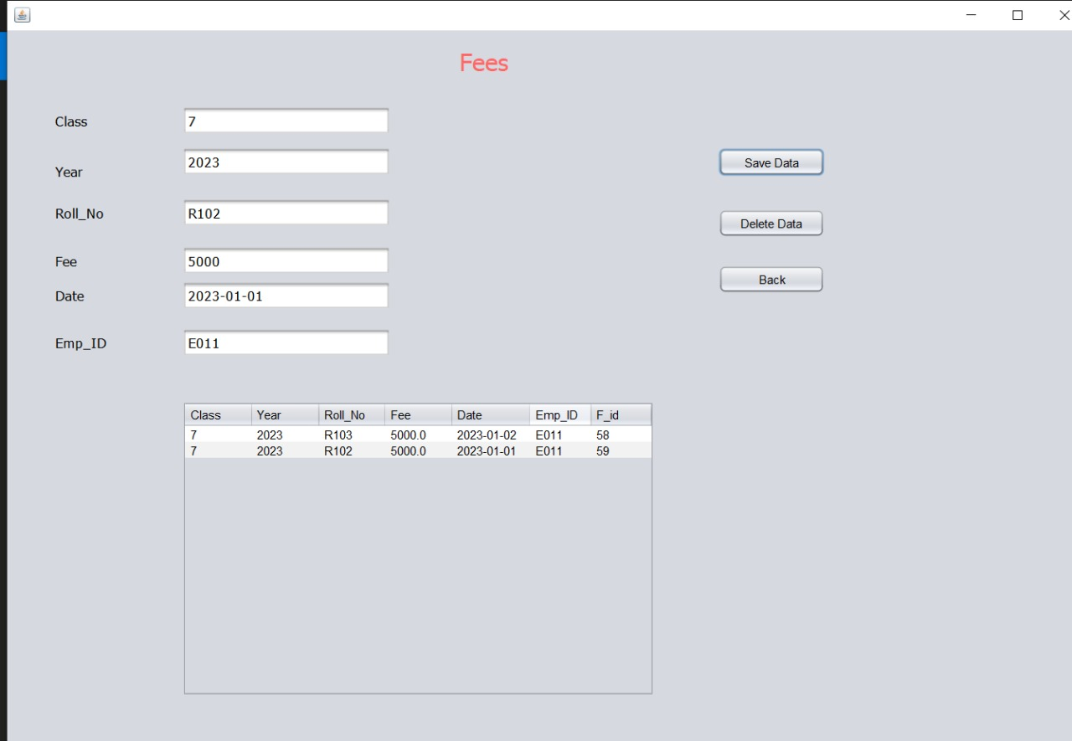
Student fee:

Slide 22
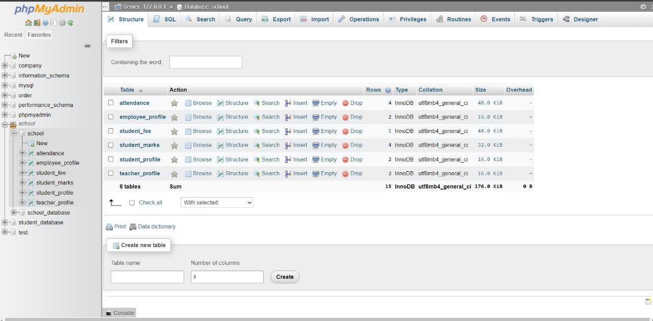
BACK TABLES
Backend tables:

Slide 23
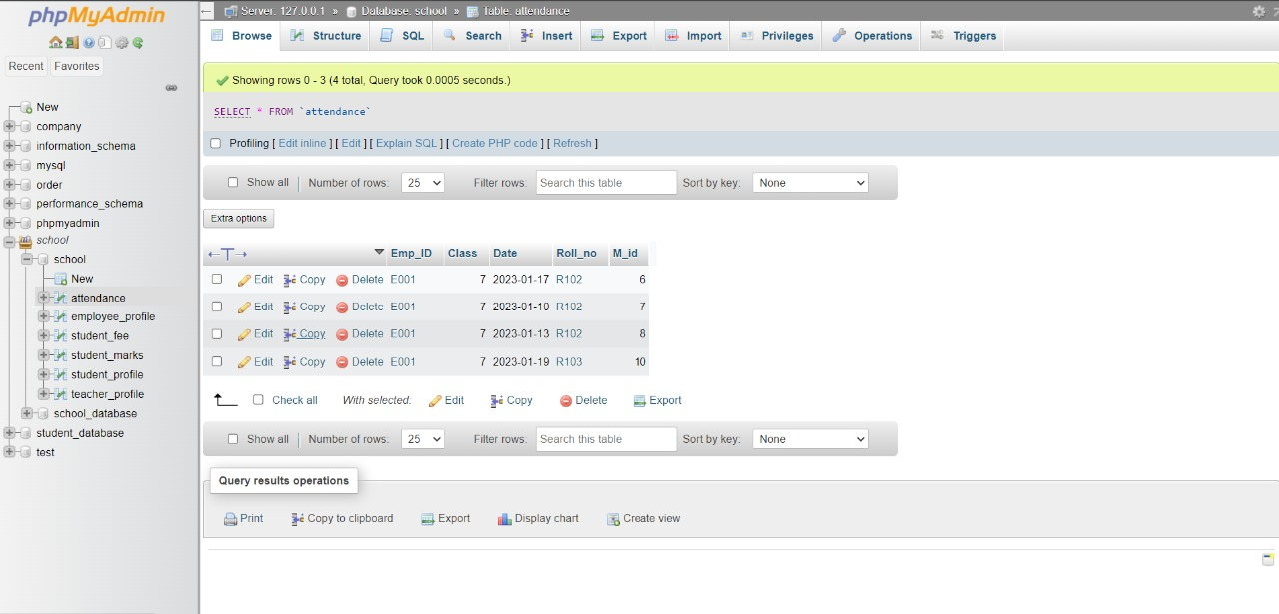
Attendance Table:

Slide 24
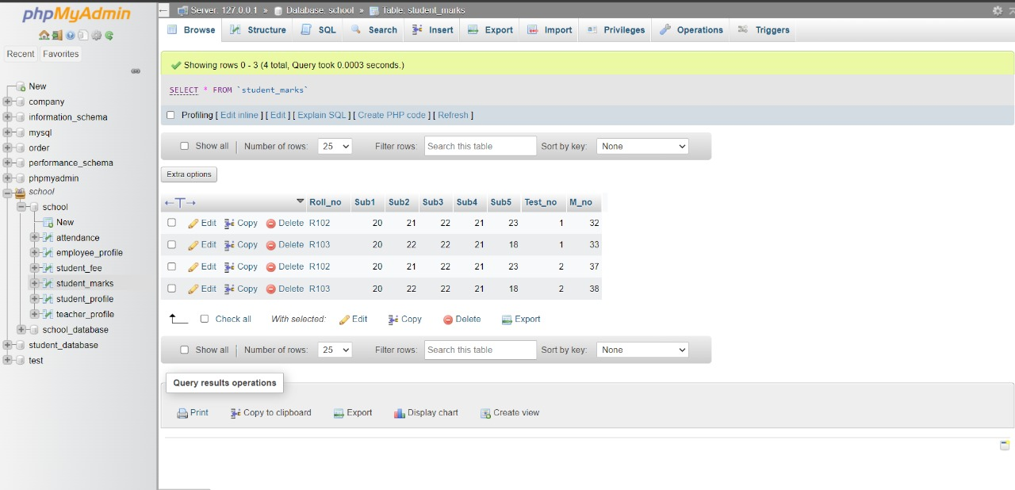
Student marks:

Slide 25
CONCLUSION
Today management is one of the most essential features of all form. Management provides sophistication to perform any kind of task in a particular form. This is school database management system; it is used to manage most school related activities. The primary aim of is to provide flexible use of school record.
We may also conclude that by using school software, processing the new records and appending the data can be done quickly and simply with just a few keystrokes or mouse clicks with new, easy to learn and use Graphical User Interface (GUI) school management solution. This website provides a computerized version of school management system which will benefit the students as well as the staff of the school, Makes entire process online where teachers can search access student record and update the student academic details.
This project is to design an efficient maintain database system and it will make easy to access the records based on requirement.

Slide 26
FUTURE SCOPE
The future scope of this project SCHOOL DATABASE MANAGEMENT SYSTEM is very spacious. There are many additional features, which are planned to be incorporated during the future enhancements of this project maybe provide facility that many more features such as online lectures video tutorials can be added by teachers as well as online assignments submission facility. Project also fulfills each users need in the best way possible .The Future version of System there is some point that we may implement on them developing an application for android devices that works on the same database using MySQL.

Slide 27
REFERENCES
[1]. Ramez Elmasri and Shamkant B. Navathe, “Database systems Models, Languages, Design and Application Programming”, Pearson, 7th Edition, 2017.
[2]. Raghu Ramakrishnan, and Gehrke, “Database management systems”, McGraw Hill, 3rd Edition, 2014.
[3]. Herbert Schildt: JAVA the Complete Reference, 7th/9th Edition, Tata McGraw Hill, 2007.
[4]. Jim Keogh: J2EE-TheCompleteReference, McGraw Hill, 2007.

